Slide 1
Java Lecture 10

Slide 2
Object oriented Programming
Inheritance:
    Passing of properties(member function and data member) from one class to another.
    The class that gives the properties is called base/super/parent class.
    The class the receive the properties is called derive /sub/child class.
    Need of Inheritance
      Reusability
      Extending
      Overloading
      Overriding

Slide 3
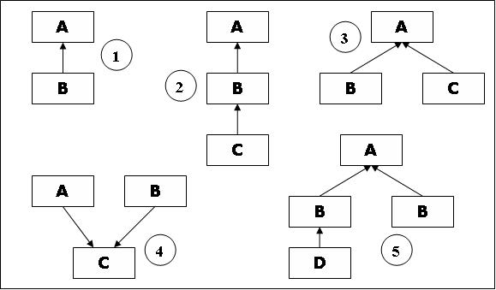
Object oriented Programming
Types of inheritance:-
  Single
  Multiple
  Multilevel
  Hybrid
  Hierarchical
Note:
  To call constructor of base class. (super(<args>))
  To call overridden function. (super functionName(<args>));

Slide 4
Object oriented Programming
Polymorphism:
  Function Overloading:
    Defining function again with same name ,different argument in the same class
  Function Overriding:
    Defining function again with same name ,same arguments in different classes(base & derive)

Slide 5
Object oriented Programming
Static keyword:
  Static data:
    Any data declared as static is shared by all the objects.
    To access static data syntax is:
      ClassName.DataName;
    Need:
      To save memory .
      To perform sharing.
class Abc
{
int a;
int b;
static int c;
}
Main()
{
Abc x=new Abx();
Abc y=new Abx();
Abc z=new Abx();
}
x y z
a a a
b b b
c

Slide 6
Object oriented Programming
Static keyword:
  Static method:
    No need to create object
    To invoke a static method
      ClassName.methodName(<args>);
    Methods that work on static data should be declared as static.
    Methods that do not work on any member data are also declared static .E.g.: main();

Slide 7
Object oriented Programming
Final Keyword:
  Final data:
    Any data if declared as final can not be changed.(to declare constant)
    Final member data should be declared static.
    Eg : static final int a =10;
  Final method:
    Ant method if declared as final can not be overridden.
    Eg: final fac(int a)
    {
    }
  Final class:
    Any class if declared as final can not be inherited
    It is used to end hierarchy.
    E.g. final className
        {
        }

Slide 8
Object oriented Programming
Abstract Keyword:
  Abstract method:
    Any method if declared as abstract should be overridden.
    These methods does not contain any statements they only enforces symmetry in hierarchy.
  Abstract class:
    Any class contain abstract function should be declared as abstract.
    No object of abstract class is created.
    These class starts new hierarchy and defines rules for these hierarchies by abstract methods.

